Slide 1

FORMAÇÃO DESENVOLVIMENTO WEB
SMALL WINS
MÓDULO 4 – Aprendendo CSS

Slide 2
RESPONSIVE DESIGN
RESPONSIVE DESIGN
IMAGENS QUE SE ADAPTAM AO TAMANHO DA TELA
MEDIA QUERIES
LAYOUT BASEADO EM GRID FLUIDO

Slide 3
Porque usar arquivos e
RESIZABLE IMAGES
img {
max-width: 100%;
height: auto;
}
MEDIA QUERIES
@media only screen and (max-width: 600px) {
body {
background-color: red;
}
}
FLUID GRID BASED LAYOUT
DEPENDE DA TÉCNICA UTILIZADA

Slide 4
RESPONSIVE DESIGN
LAYOUT BASEADO EM GRID FLUIDO
FLOAT
FLEXBOX
CSS GRID

Slide 5
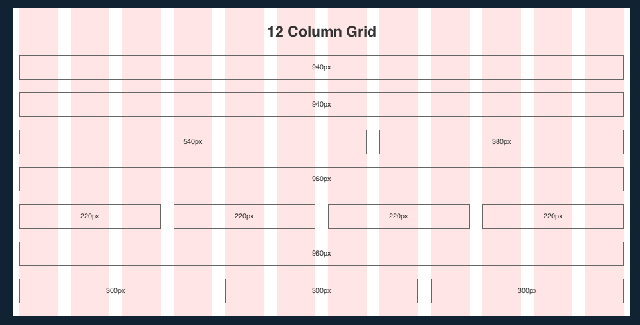
RESPONSIVE DESIGN

Slide 6
RESPONSIVE DESIGN – USANDO FLOAT
.row
cell / .col-1
cell / .col-1
cell / .col-1
cell / .col-1
<div class=“row”>
<div class=“col-1”></div>
<div class=“col-1”></div>
<div class=“col-1”></div>
<div class=“col-1”></div>
</div>
.row::after {
content:””;
display: table;
clear:both;
}
.col-1 {
float: left;
margin-left: 4%;
width: 20%;
}

Slide 7
RESPONSIVE DESIGN – USANDO FLOAT
.row
@media only screen and (min-width: 480px)
and (max-width: 767px)
{
.col-1 {
width: 44%;
}
}
cell / .col-1
cell / .col-1
cell / .col-1
cell / .col-1

Slide 8
RESPONSIVE DESIGN – USANDO FLOAT
.row
cell / .col-1
@media only screen and (max-width: 479px)
{
.col-1 {
width: 98%;
margin: 1%;
float: none;
}
}
cell / .col-1
cell / .col-1
cell / .col-1

